Slide 1

Understanding
a Statement
Notes:
Start off thanking our hosts, IMS
This PowerPoint was developed by the ADL Initiative, May 2016. It presents a high-level introduction to xAPI and the rationale behind using it. For more information contact the ADL initiative by visiting www.adlnet.gov and clicking the Contact Us link. If shared, please give attribution to the ADL Initiative (Sae Schatz, Director), 2016.

Slide 2

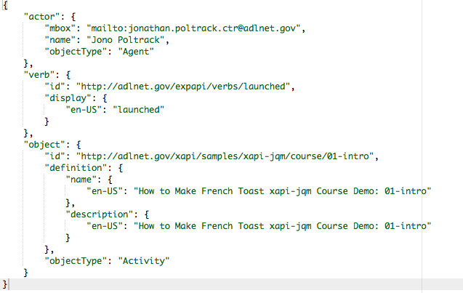

Notes:
JSON data representation
“I did this” basic structure
Add
Result
Context
Attachments
xAPI in 30 Seconds
Each meaningful interaction between the learner and content is logged via xAPI calls
Interaction statements take from “I did this”
Logged via simple REST API
An internet-enabled device can participate
Enables big-data analytics on learner data
Data has to be stored somewhere

Slide 3


JSON
XML
{
"company": Volkswagen,
"name": Vento,
"price": 80000
}
<car>
<company>Volkswagen</company>
<name>Vento</name>
<price>80000</price>
</car>
JavaScript Object Notation (JSON)
Text-based open standard for human readable data exchange
Notes:
JavaScript Object Notation (JSON)
Much lighter-weight
Object-based
Text-based open standard for human readable data exchange
XML
Heavier = slower
Algorithmic; high overhead for OO

Slide 4
Actor
Verb
Object
Required
Result
Attachments
Timestamp
Context
Optional
Authority
Stored
Version
Automatic
{ xAPI Statement Components }

Slide 5
Notes:
JSON data representation
“I did this” basic structure
Add
Result
Context
Attachments
xAPI in 30 Seconds
Each meaningful interaction between the learner and content is logged via xAPI calls
Interaction statements take from “I did this”
Logged via simple REST API
An internet-enabled device can participate
Enables big-data analytics on learner data
Data has to be stored somewhere

Slide 6

"actor": {
"mbox": "mailto:jonopoltrack@gmail.com",
"name": "Jono Poltrack",
"objectType": "Agent"
}
Notes:
The “I” part of the “I did this” statement
Can be a
Single learner
Group
Represented by:
Email
Account
open ID
Different than
the "authority”

Slide 7
Notes:
JSON data representation
“I did this” basic structure
Add
Result
Context
Attachments
xAPI in 30 Seconds
Each meaningful interaction between the learner and content is logged via xAPI calls
Interaction statements take from “I did this”
Logged via simple REST API
An internet-enabled device can participate
Enables big-data analytics on learner data
Data has to be stored somewhere

Slide 8

"verb": {
"id": "http://adlnet.gov/expapi/verbs/initialized",
"display": {
"en-US": "initialized"
}
}
Notes:
ADL-standard verbs
Completed
Initialized
Launched
Keep in mind the special word “voided” http://adlnet.gov/expapi/verbs/voided

Slide 9
"verb": {
"id": "adlnet.gov/expapi/verbs/voided",
"display": {
"en-US": "initialized"
}
}
Notes:
ADL-standard verbs
Completed
Initialized
Launched
Keep in mind the special word “voided” http://adlnet.gov/expapi/verbs/voided

Slide 10
Notes:
JSON data representation
“I did this” basic structure
Add
Result
Context
Attachments
xAPI in 30 Seconds
Each meaningful interaction between the learner and content is logged via xAPI calls
Interaction statements take from “I did this”
Logged via simple REST API
An internet-enabled device can participate
Enables big-data analytics on learner data
Data has to be stored somewhere

Slide 11

"object": {
"id": "http://adlnet.gov/xapi/samples/xapi-jqm/course/",
"definition": {
"name": {
"en-US": "How to Make French Toast xapi-jqm Course Demo"
},
"description": {
"en-US": "French Toast Cooking Course built on JQuery Mobile"
}
},
"objectType": "Activity"
}
Notes:
Object
The “this” part of the “I did this” statement
Object is typically an “activity” but could also be an “agent”, “substatement” or “statement reference”
Activities can be of different granularities and types

Slide 12

"result": {
"score": {
"scaled": 0.7,
"raw": 70,
"max": 100
},
"success": true,
"completion": false
}
Notes:
Result
Adds to the “I did this” statement by allowing a “result” to be appended
Result can include:
Score (Scaled, Raw,
Min, Max)
Completion
Success
Response
Duration
Extensions
Voided
Statements are immutable
What happens if a statement contains a mistake?
Use the voiding verb (http://adlnet.gov/expapi/verbs/voided)

Slide 13

"context": {
"contextActivities": {
"grouping": [
{
"definition": {
"name": {
"en-US": "TECOM Workshop"
},
"description": {
"en-US": "TECOM Workshop happening Nov 2016"
}
},
"id": "http://adlnet.gov/event/xapiworkshop/tecom",
"objectType": "Activity"
}
]
}
}
Notes:
Context
A place for contextual information about a statement
Context can include:
Registration
Context Activities
Instructor
Team
Context is important for querying data later

